Slide 1
Intro to Clustering
Daro VAN

Slide 2
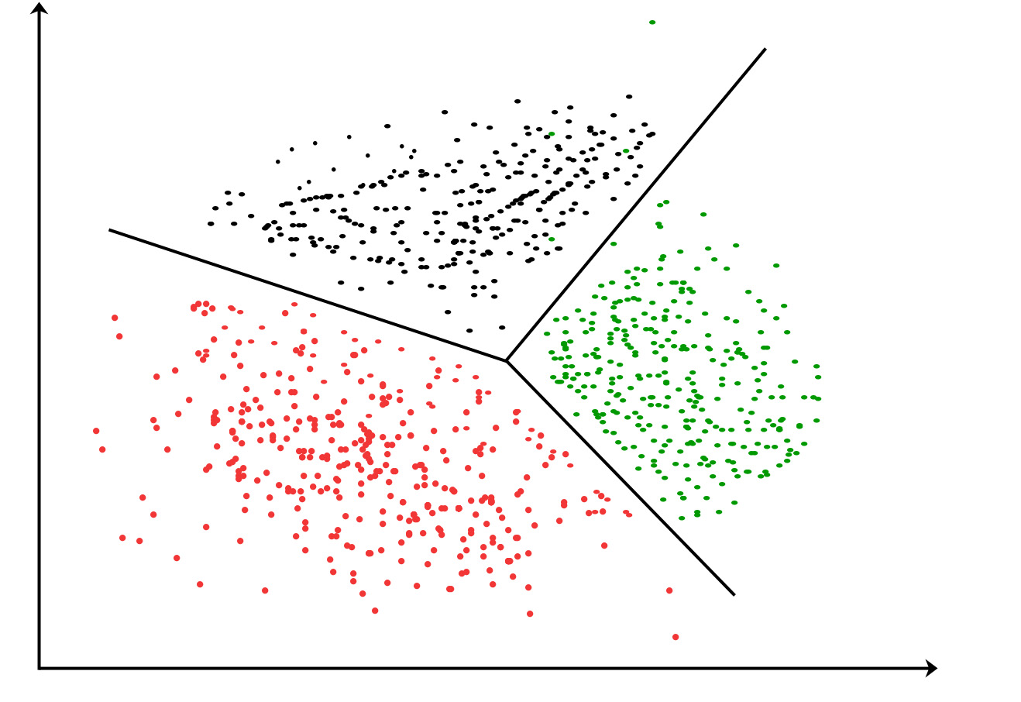
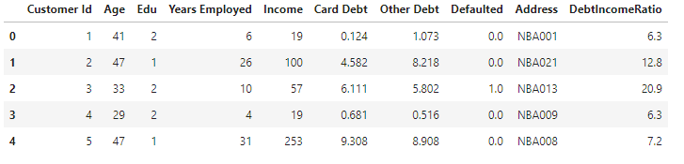
Clustering for segmentation
Imagine you have a data and you have to apply customer segmentation to this data.
Customer segmentation is the practice of partitioning a customer base into groups of individuals that have similar characteristics. It allows the business to target specific groups of customers so as to more effectively allocate marketing resources.

Slide 3
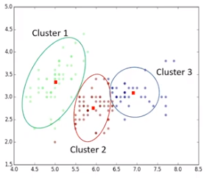
What is clustering
Clustering means finding the clusters in the data unsupervised.
Cluster is a group of objects that are similar to other objects in the cluster, and dissimilar to data points in other clusters.

Slide 4
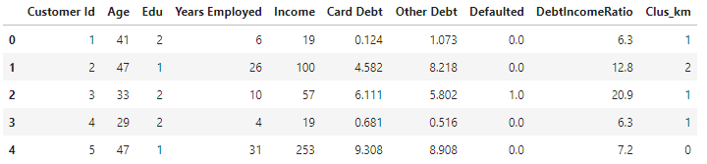
Clustering Vs. Classification
Modeling
Model
Labeled dataset
Prediction
modeling
Model
Unlabeled dataset

Slide 5
Clustering application
Retail/marketing Identifying buying patterns of customers Recommending new books or movies to new customers
Banking Fraud detection in credit card use Identifying clusters of customers (e.g. loyal or churn …)
Insurance Fraud detection in claim analysis Insurance risk of customers
Publication Auto-categorizing news based on their content Recommending similar new article
Medicine Characterizing patient behavior
And more

Slide 6
What clustering ?
Exploratory data analysis
Summary generation
Outlier detection
Finding duplicates
Pre-processing step

Slide 7
Clustering algorithms
Partitioned-based clustering Relatively efficient Ex. K-Means, K-Median, Fuzzy c-Means
Hierarchical clustering Produces trees of clusters Ex. Agglomerative, Divisive
Density-Based clustering Produces arbitrary shaped clusters Ex. DBSCAN

